Slide 1
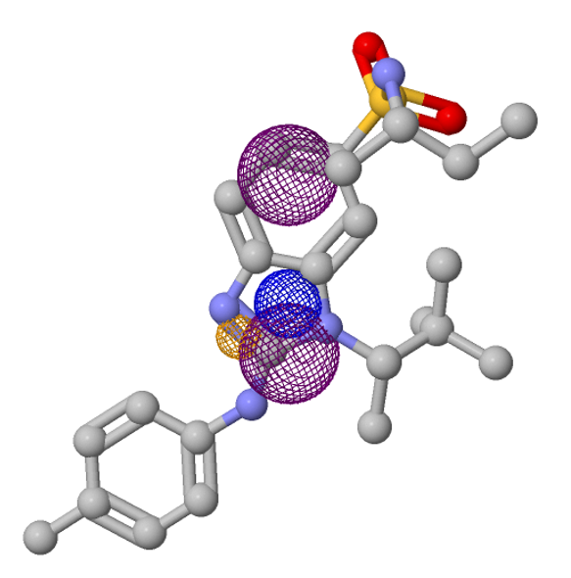
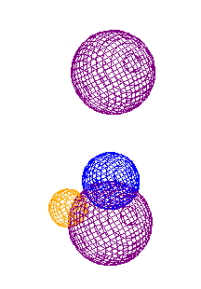
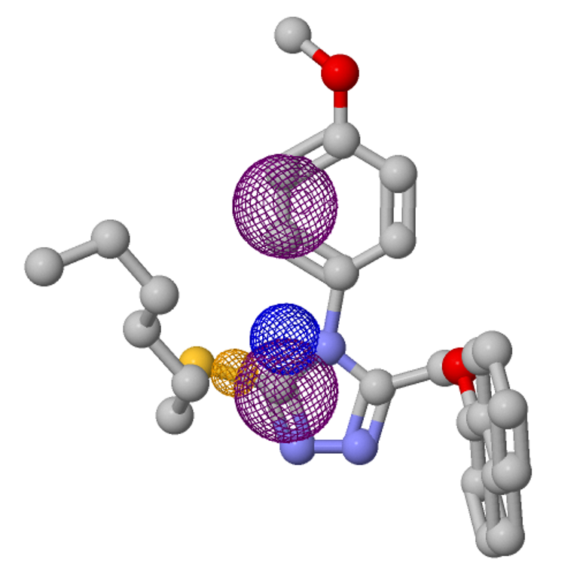
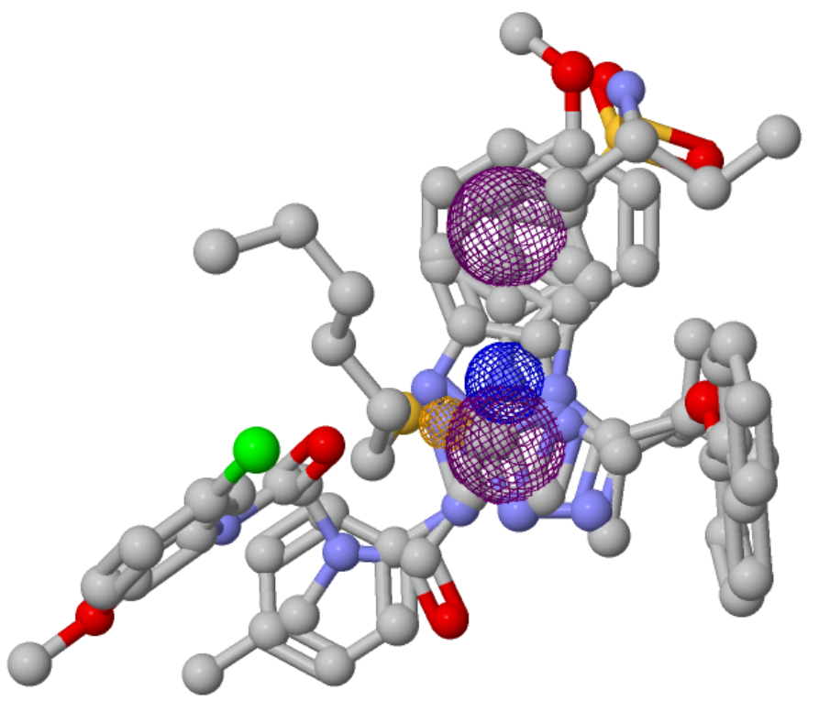
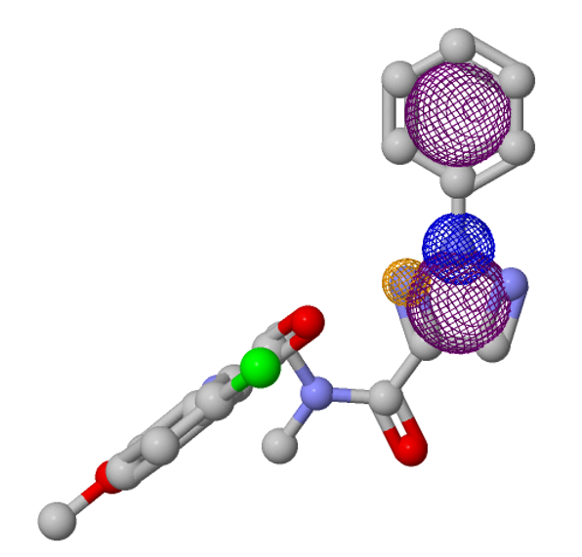
D
E
A
Aromatic
3.7
2.8
3.7
3.9
Hydrogen
Acceptor
Positive
1.3
B
1.2
1.1
Aromatic
1.2
F
C

Slide 2
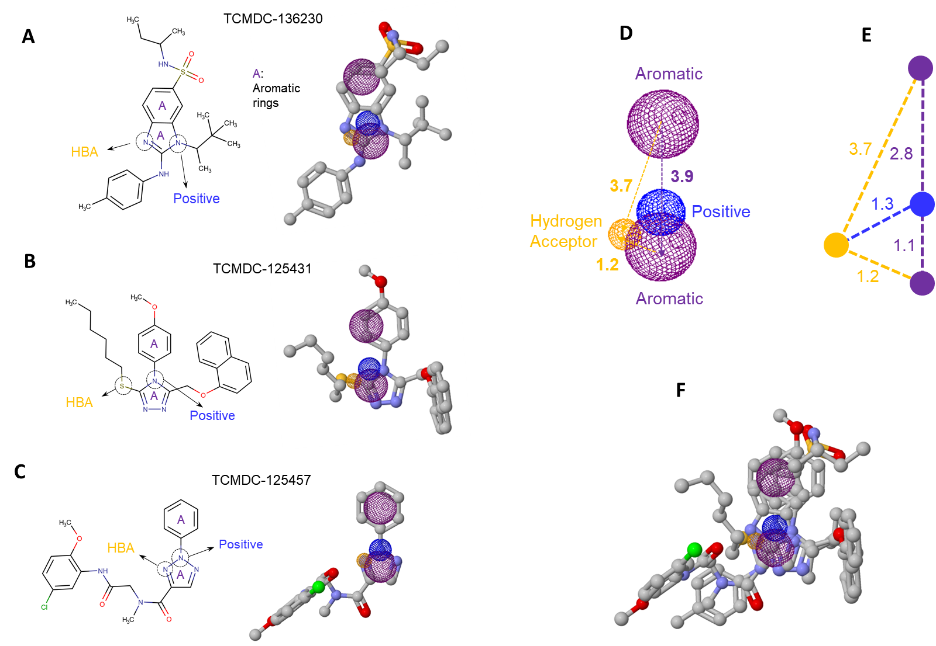

Slide 3
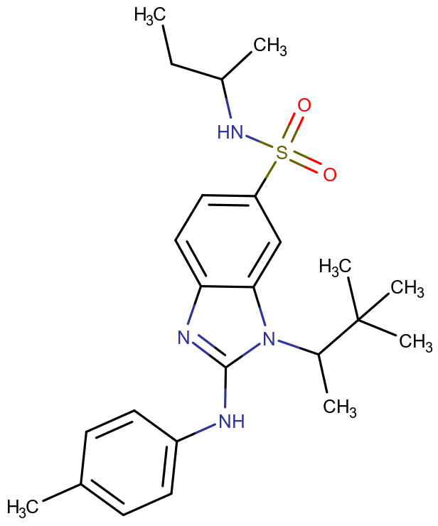
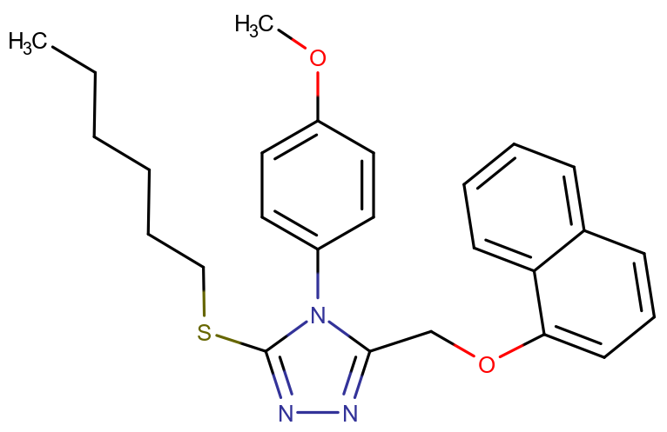
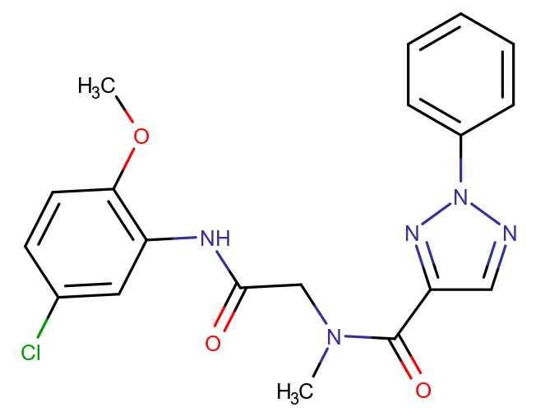
A
TCMDC-136230
D
E
A: Aromatic rings
Aromatic
A
A
3.7
HBA
2.8
3.7
3.9
Positive
Positive
1.3
Hydrogen
Acceptor
B
1.1
TCMDC-125431
1.2
1.2
Unit: Å
Aromatic
A
A
F
HBA
Positive
RMSD to Pharmacophore Model E (4 atoms RMSD):
A (TCMDC-136230): 1.063 Å
B (TCMDC-125431): 1.054 Å
C (TCMDC-125457): 0.004 Å
C
TCMDC-125457
A
HBA
Positive
A

Slide 4
Fit scores of Pharmacophore Models: the first one with highest score was selected. The score was calculated by the weighted sum of the matched pivot features (0.3 for hydrophobicity and 1 for the rest))
Score | Jmol | Features | Spatial Features | Aromatic | Hydrophobic | Donors | Acceptors | Negatives | Positives | Molecules
20.821 | Jmol | 4 | 4 | 2 | 0 | 0 | 1 | 0 | 1 | abc_3.mol2 abc_1.mol2 abc_2.mol2
18.371 | Jmol | 3 | 3 | 2 | 0 | 0 | 1 | 0 | 0 | abc_3.mol2 abc_1.mol2 abc_2.mol2
18.371 | Jmol | 3 | 3 | 2 | 0 | 0 | 1 | 0 | 0 | abc_1.mol2 abc_2.mol2 abc_3.mol2
17.146 | Jmol | 4 | 4 | 1 | 0 | 0 | 2 | 0 | 1 | abc_1.mol2 abc_2.mol2 abc_3.mol2
15.432 | Jmol | 3 | 3 | 2 | 1 | 0 | 0 | 0 | 0 | abc_3.mol2 abc_1.mol2 abc_2.mol2
15.432 | Jmol | 3 | 3 | 2 | 1 | 0 | 0 | 0 | 0 | abc_1.mol2 abc_2.mol2 abc_3.mol2
14.697 | Jmol | 3 | 3 | 1 | 0 | 0 | 2 | 0 | 0 | abc_1.mol2 abc_2.mol2 abc_3.mol2
13.472 | Jmol | 3 | 3 | 1 | 0 | 0 | 1 | 0 | 1 | abc_1.mol2 abc_2.mol2 abc_3.mol2
11.758 | Jmol | 3 | 3 | 1 | 1 | 0 | 1 | 0 | 0 | abc_3.mol2 abc_1.mol2 abc_2.mol2
11.758 | Jmol | 3 | 3 | 1 | 1 | 0 | 1 | 0 | 0 | abc_2.mol2 abc_1.mol2 abc_3.mol2

